Slide 1


An integrated assessment of energy sources, CO₂ emissions, and long-term transition pathways.
CO₂ Emissions & Energy Production Analysis
(2000–2050)
Group 20
Team members：
Bharath Chandran Madhaiyan
Gibson G
Vishal Prabakaran
Xier Wang
Yuxuan Huang
BUSINFO 701 · 2025

Slide 2




Key drivers
Trend
Why Green Energy Matters
Links between GDP, energy mix, and emissions provide insights for 2050 pathways
Forecast
Explore links between GDP, energy mix, and emissions
Global CO₂ emissions continue rising
Energy production is the largest emission source
Countries differ significantly in development & capacity
Understanding these differences supports policy & industry decisions
Difference among countries
Compare developed, developing, and underdeveloped countries
Potential insight
Highlighting areas where policy and investment can accelerate progress

Slide 3



Datasets Overview
CO₂ Emissions (OECD)
Electricity Mix (Energy Yearbook)
Annual CO₂ emissions from energy-related sectors
Coverage: 76 countries, 2000–2024
✔ Used to examine long-term emission patterns
Dataset 1
Dataset 2
Shares of Fossil, Nuclear, and Renewable generation
Coverage: 2000–2024
✔ Used to compare energy structures across country groups
GDP (World Bank)
Dataset 3
GDP in constant USD
Coverage: 2000–2024
✔ Used to compare economic capacity across countries

Slide 4

Datasets Overview
CO₂ Emissions (OECD)
Electricity Mix (Energy Yearbook)
Annual CO₂ emissions from energy-related sectors
Coverage: 76 countries, 2000–2024
✔ Used to examine long-term emission patterns
(*Appended secondary CO₂ emission dataset for majorly missing countries.)
Dataset 1
Dataset 2
Shares of Fossil, Nuclear, and Renewable generation
Coverage: 2000–2024
✔ Used to compare energy structures across country groups
Dataset 3
Dataset 4
GDP (World Bank)
Population(Worldometer)
GDP in constant USD
Coverage: 2000–2024
✔ Used to compare economic capacity across countries
Annual population estimates
Coverage: 2000–2024
🌐 Web Scraping
✔ Used to calculate GDP per capita and contextual indicators

Slide 5





Data Processing
Step 05
Step 04
Step 03
Trend Analysis & Projection
Step 02
Data Integration
Assessed historical energy trends and group differences
Produced projections for 2025–2050
Step 01
Data Cleaning & Standardization
Merged by Country + Year
Added GDP per capita
Data Inspection
Standardized names, formats, units
Removed aggregates and retained energy-related CO₂ sectors
Checked completeness, missing records, and naming consistency
Ensured aligned time ranges across datasets
Data Collection
CO₂ Electricity Mix , GDP & Population
Coverage: 76 countries, 2000–2024

Slide 6

Final Dataset Summary
Category | Details
🌍 Country Groups | 76 countries grouped into 3 groups (Developed, Developing, Underdeveloped)
📅 Years Covered | Actual data: 2000–2024; Projected data: 2025–2050
📊 Observations | 1900 actual observations (2000–2024)
🔮 Projected Observations | 1,976 projected observations (2025–2050)
⚡ Energy Variables | Electricity Mix (% Fossil, % Renewable, % Nuclear)
🧩 Other Variables | CO₂ Emission (Tonnes); GDP (B USD); Population; GDP per capita
🔗 Merge Keys | Combined using Country + Year
🗂️ Final Dataset Composition | Unified table containing energy mix, CO₂ emissions, economic indicators and population
Currency adjusted to constant USD
Measures renewable vs fossil share
Estimated values for some regions

Slide 7
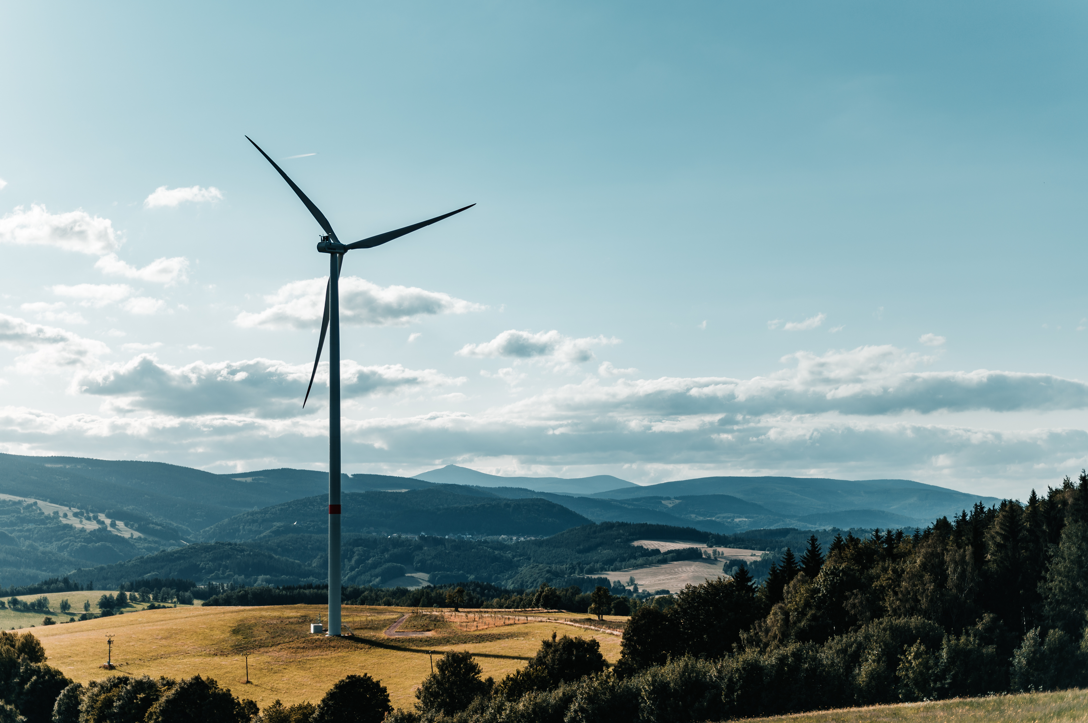
What we found?

Slide 8
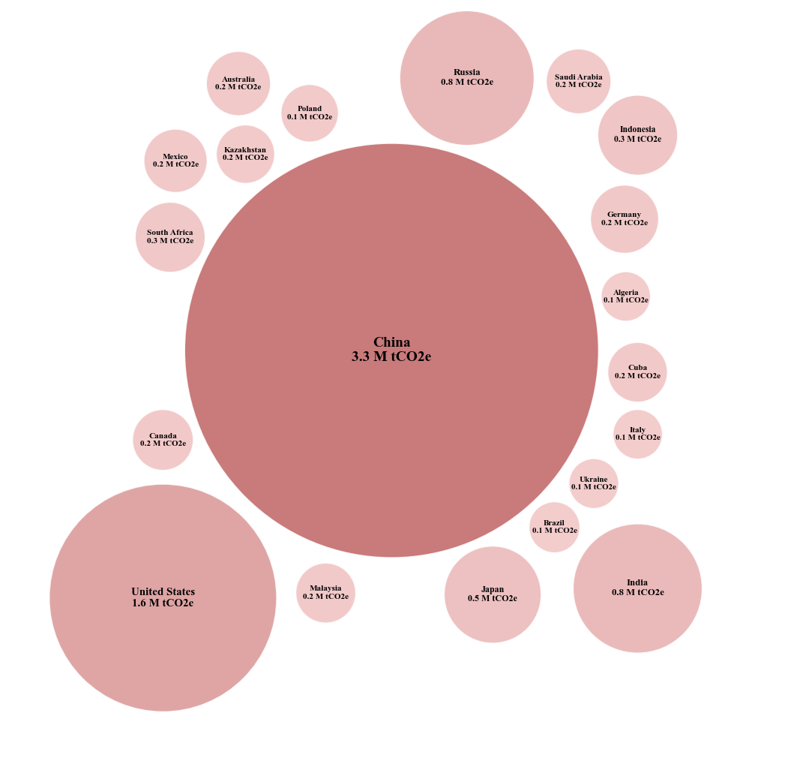
Q1 . Which countries generate the highest CO₂ emissions in 2024, and how do these results differ when comparing emissions per capita?
Top 20 CO2 Emitting Countries in 2024
🏭 Main points：
China emits far more than any other country (3.3M tCO₂e).
The US follows with around 1.6M tCO₂e.
* Large economies dominate total emissions.

Slide 9
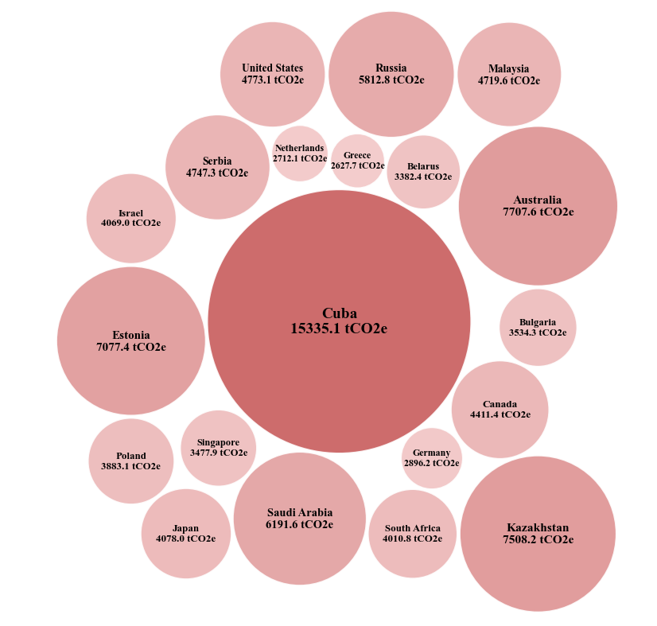
Q1 . Which countries generate the highest CO₂ emissions in 2024, and how do these results differ when comparing emissions per capita?
Top 20 Countries by CO2 Emissions Per Capita in 2024
(Tonnes per person)
🏭 Main points：
Cuba leads by a huge margin (~15k tCO₂e per person).
Australia, Kazakhstan, Russia also rank high.
* Small, industrial or fossil-heavy countries dominate per-capita emissions.
Key insight:
The biggest total emitters are large economies like China and the US, but the highest per-capita emitters are small, fossil-intensive countries.

Slide 10
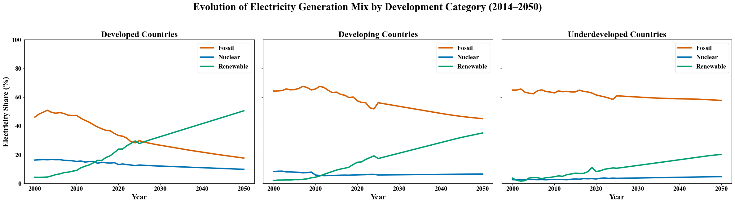
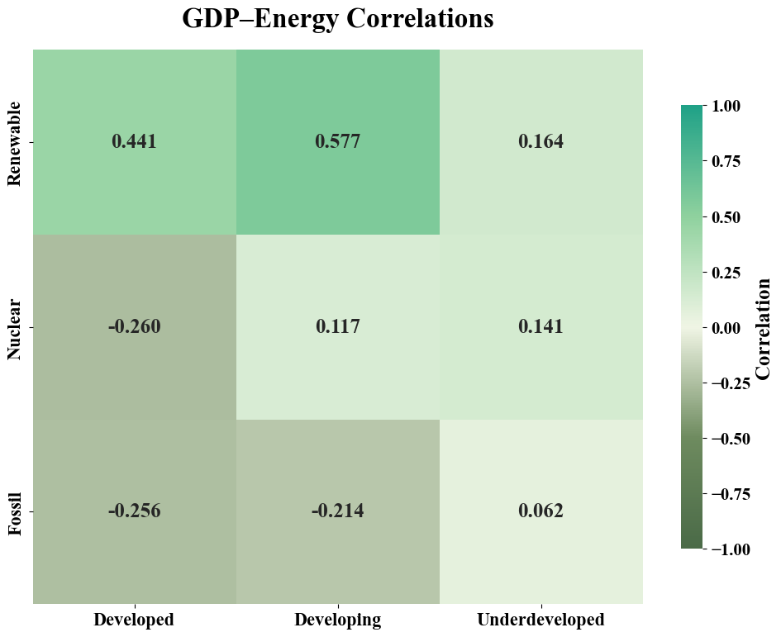
Q2. How has global electricity production moved to a clean power over 50 years across different country groups?
🔵 Developed Countries
Fossil ↓↓ (sharp decline)
Renewables ↑↑ (become dominant by 2050)
Nuclear → (stable)
🟠 Developing Countries
Fossil ↓ (moderate decline)
Renewables ↑ (not dominant)
Nuclear → (minimal)
🟢 Underdeveloped Countries
Fossil → (still high) Renewables ↑ (slow)
Nuclear → (almost none)
🔋
Higher GDP → more renewables
Lower GDP → more fossil fuels
Nuclear shows weak correlation
Key Insight:
Global clean-energy progress is GDP-driven:
High-GDP countries decarbonize early and rapidly, while lower-GDP groups remain fossil-locked due to cost, infrastructure gaps, and slower technology diffusion.

Slide 11
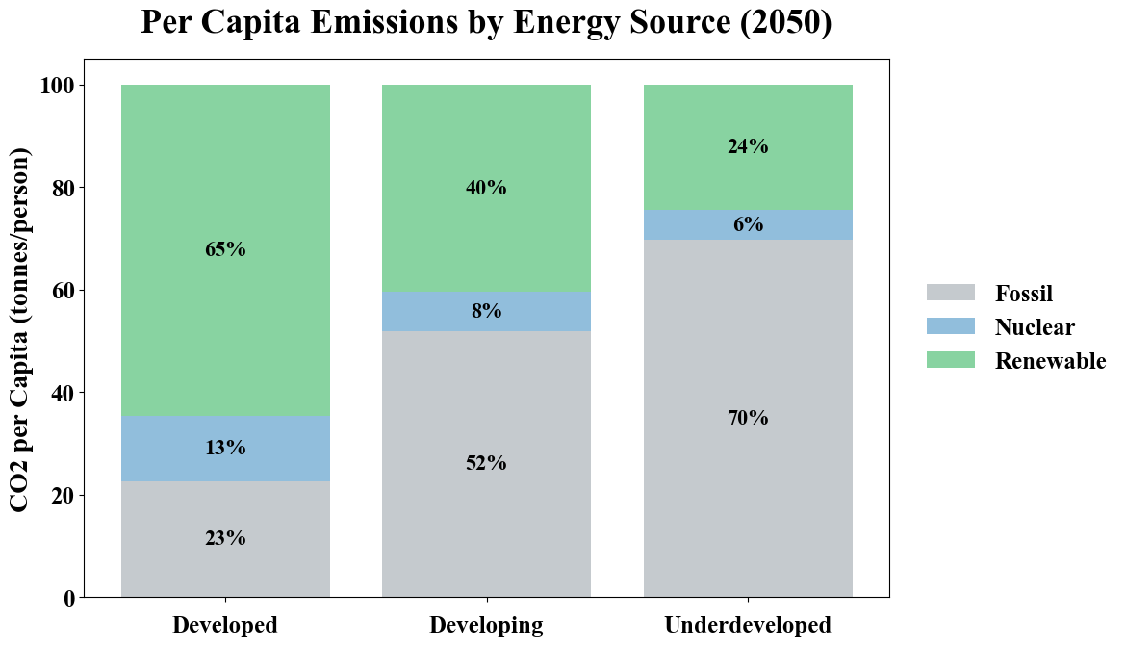
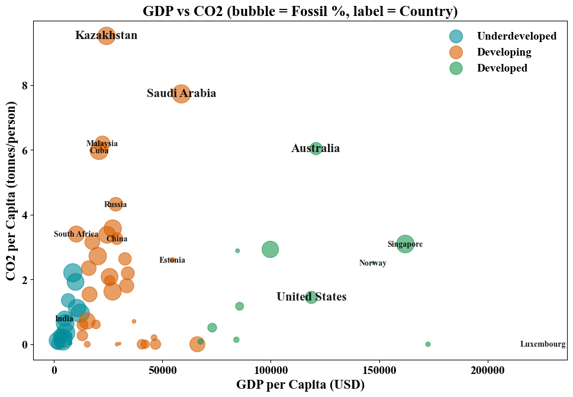
Q3. What is the relationship between energy mix composition and CO₂ emissions per capita in 2050 across development groups?
Highest GDP
Developed Country
Highest CO₂
Developing Country
Highest Fossil Reliance
Developing & Underdeveloped
Country
* Developing countries show the highest CO₂
Key Insight:
By 2050, developing countries emit the most CO₂ per capita because their economic growth remains heavily dependent on fossil fuels, while developed countries show partial decoupling between income and emissions.
Status | Fossil | Nuclear | Renewable
Developed | 23% | 13% | 65%
Developing | 52% | 8% | 40%
Underdeveloped | 70% | 6% | 24%
* Larger bubbles = Fossil-heavy economies
* Developing and underdeveloped groups remain fossil-dominant.

Slide 12
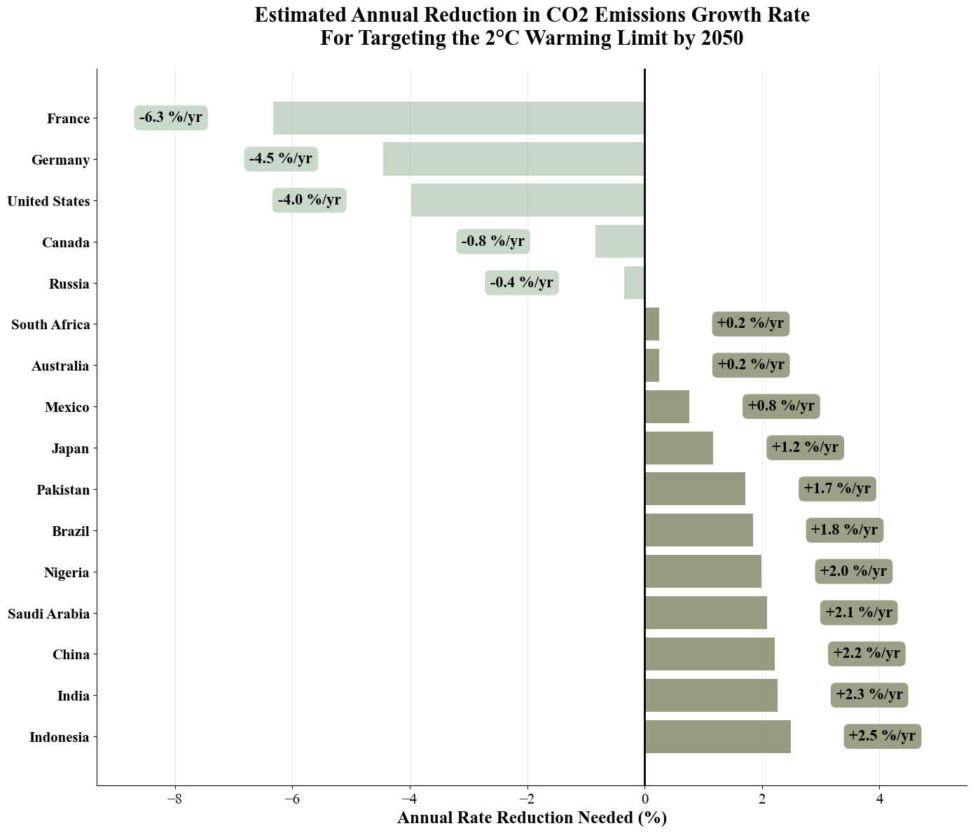
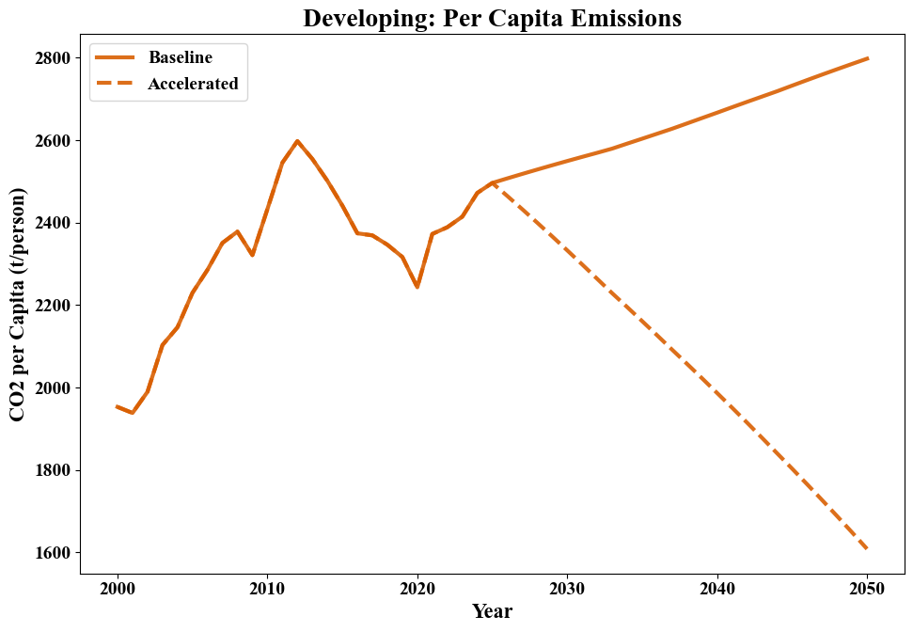
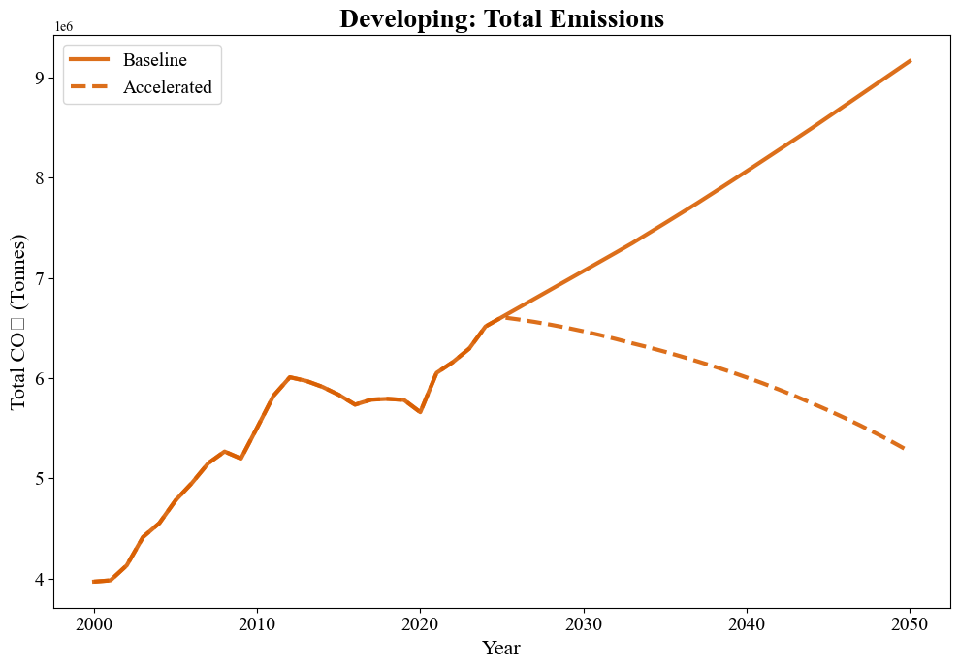
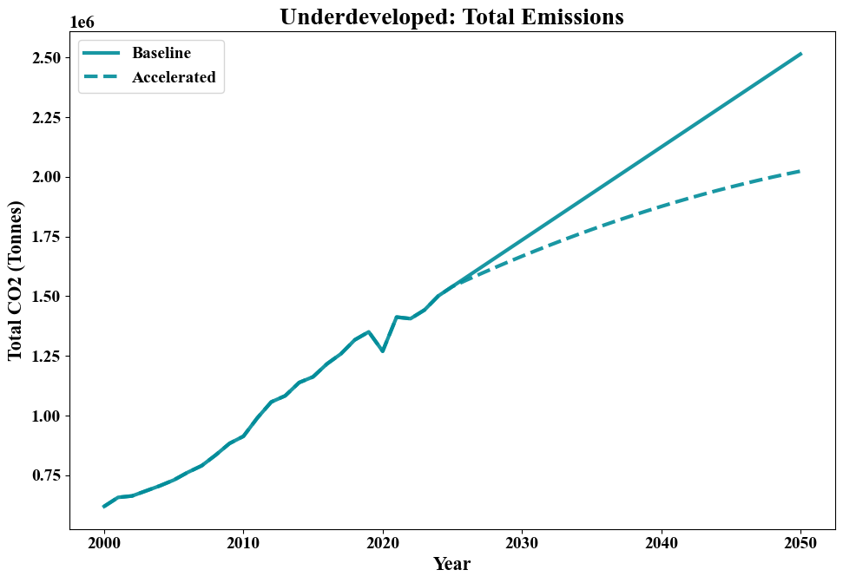
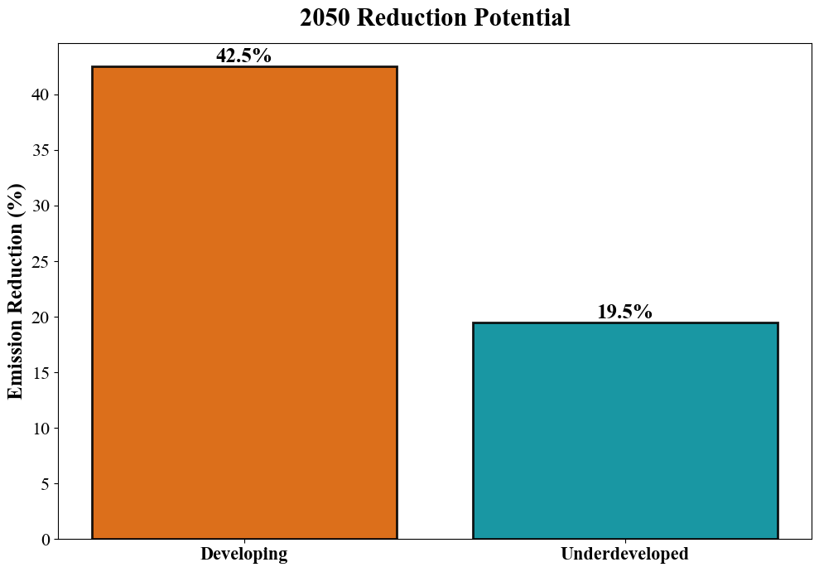
Q4 . Which countries must need to reduce the CO₂ emission to restrict attaining Global warming to an increase of 2°C growth by 2050 , and how could that change the future emissions path of vulnerable regions?
Total Emissions
( Developing & Underdeveloped)
* After 2025, accelerated path cuts emissions.
* Accelerated path cuts per-capita CO₂ nearly in half.
💡 In 2050
Countries requiring the largest annual CO₂ cuts : Indonesia / India / China
* Accelerated scenario slows the rise in total emissions.
* Rapidly growing economies must reduce their emission rates in order to prevent global warming from rising by another 2 degrees by 2050.
Key Insight:
Accelerated clean-energy adoption delivers the steepest decline, enabling developing and underdeveloped regions to cut 2050 emissions by 42% and 20%.

Slide 13

Key Findings
🔥 Q1 — Emitters
⚡Q2 — Energy Transition
Large economies = highest total CO₂
Small fossil-heavy = highest per-capita CO₂
High- GDP countries shift faster to renewables
Low- GDP groups stay fossil-locked
🌍 Q3 — 2050 Emissions
📉 Q4 — Future Path
Developing countries show the highest CO₂ per person by 2050
Underdeveloped and developing majorly rely on fossil fuels even at 2050
Accelerated clean-energy adoption cuts emissions by 20–40%
⭐ Global decarbonisation is uneven—driven by GDP, energy mix, and transition speed.

Slide 14


Recommendations

Slide 15
R4
Developed Countries
Phase out remaining fossil power.
Improve grid stability for high renewables ( e.g., handle solar/wind fluctuations)
Add energy storage where needed.
R3
R1
R2

Slide 16
Developed Countries
Phase out remaining fossil power.
Improve grid stability for high renewables ( e.g., handle solar/wind fluctuations)
Add energy storage where needed.
R4
Developing Countries
Scale up renewable investment.
Reduce financing barriers with government support.
Use a balanced mix with moderate nuclear (renewables + nuclear).
R3
R1
R2
Underdeveloped Countries
Increase international climate funding.
Prioritize low-cost renewable solutions (solar, onshore wind)
Explore alternate energy source such as Hydroelectric.

Slide 17
Developed Countries
Phase out remaining fossil power.
Improve grid stability for high renewables.
Add energy storage where needed.
R4
Underdeveloped Countries
Increase international climate funding.
Prioritize low-cost renewables (solar , onshore wind)
Explore alternate affordable energy such as Hydroelectric.
R3
R1
R2
Global Actions
Accelerate clean-energy investment worldwide.
Ensure grid stability as renewables scale up.
Enhance cross-border clean-tech cooperation.

Slide 18
Underdeveloped Countries
Increase international climate funding.
Prioritize low-cost renewables (solar , onshore wind)
Explore alternate energy source such as Hydroelectric.
R4
Global Actions
Accelerate clean-energy investment worldwide.
Ensure grid stability as renewables scale up.
Enhance cross-border clean-tech cooperation.
R3
R1
R2

Slide 19


Thank you for your attention!
Let the Earth Breathe Freely
Q & A
We welcome your questions and discussion.

